Slide 1

Information Security Analyst
Track
SOC T1
Project
Building and Operating a Mini Security Operations Center (SOC)
Done by :
El-hout Team
Supervised by :
ENG/ Marwan EL-Sayyad
2026
Digital Egypt Initiative (DEPI) – Round 4

Slide 2
utilizing the Elastic Stack
Project Overview
This project focuses on building a centralized Security Information
and Event Management (SIEM) system designed to monitor, detect,
and analyze security events across Linux environments
utilizing the Elastic Stack
the system provides a robust framework for real-time log management and performance tracking, ensuring a proactive defense against cyber threats

Slide 3
Project 1: Building and Operating a Mini Security Operations Center (SOC)
Objectives
Centralized Logging
Real-time Monitoring
Threat Detection
Data Visualization

Slide 4
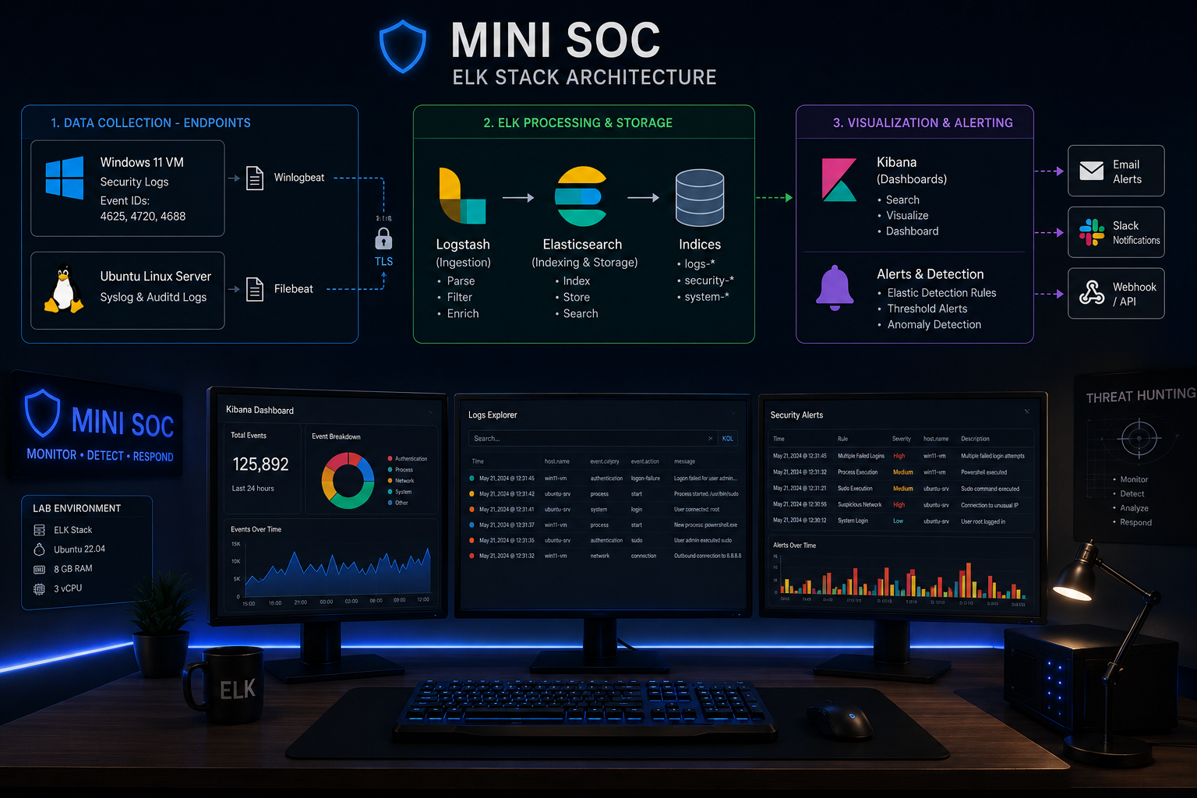

Slide 5
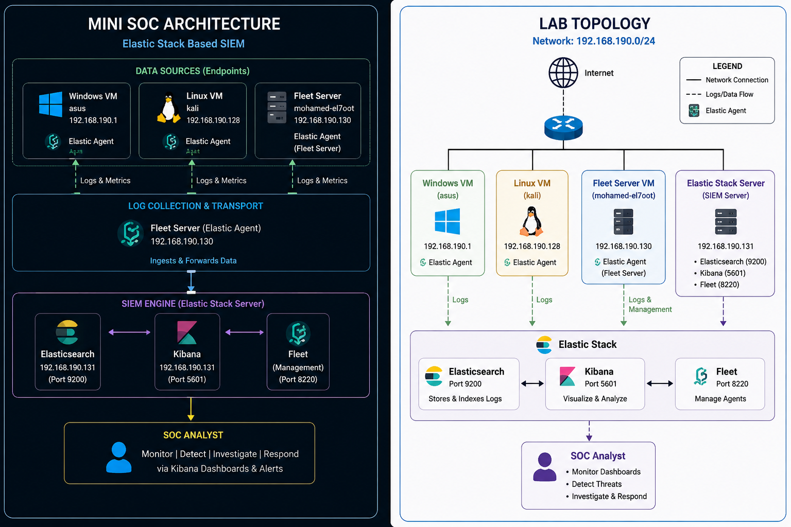
Project 1: Building and Operating a Mini Security Operations Center (SOC)
LAB TOPOLOGY

Slide 6
Week 1
SOC Setup & Log Ingestion
1-Technical Stack used
Operating System: Ubuntu 22.04 LTS
SIEM Engine: Elasticsearch 8.x
Visualization: Kibana
Log Collector: Elastic Agent

Slide 7
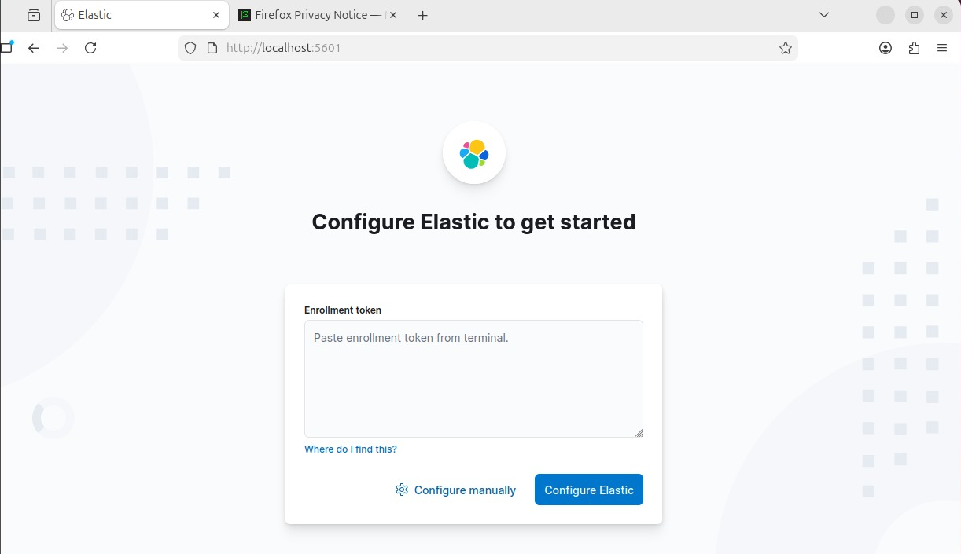
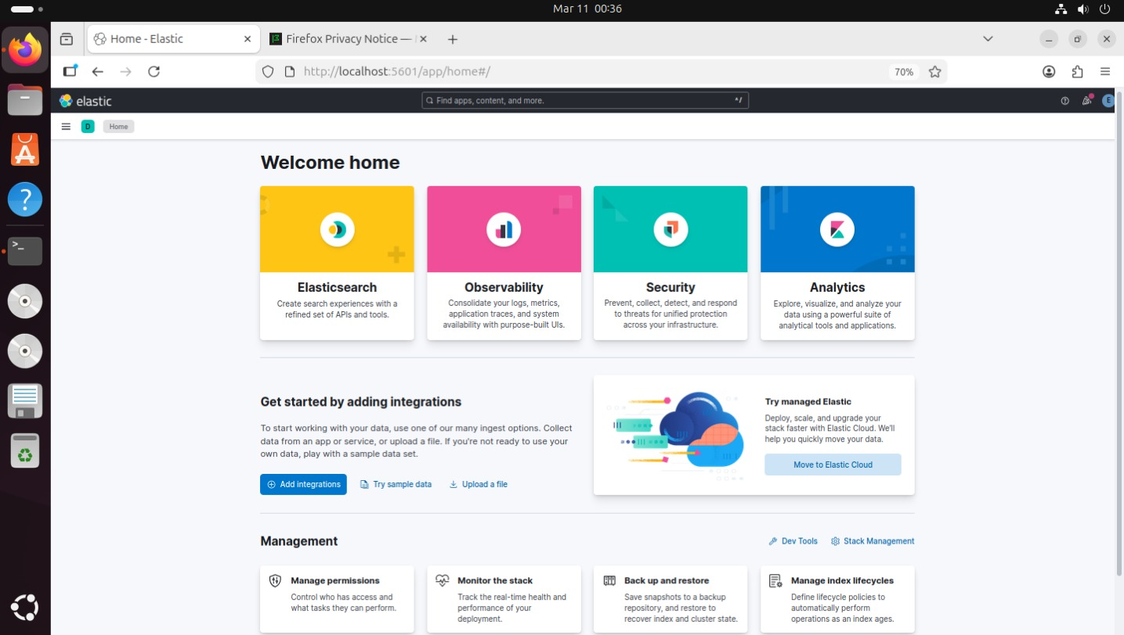
2-Implementation Phase
Step 1: Deploying the Elastic Stack
The ELK environment was set up and the security protocols (Role-based access control) were activated.
Username : elastic
Password : lEI2kcHY27G*wB9=mA1T

Slide 8

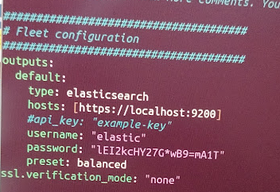
Step 2: Elastic Agent Configuration (The Challenge)
The Elastic Agent has been installed.
We found a problem
SSL Handshake (Error x509)
The problem was resolved by modifying the output configuration of the Elastic Agent .
Modify the elastic-agent.yml settings file (configuration) to link it to Elasticsearch.

Slide 9
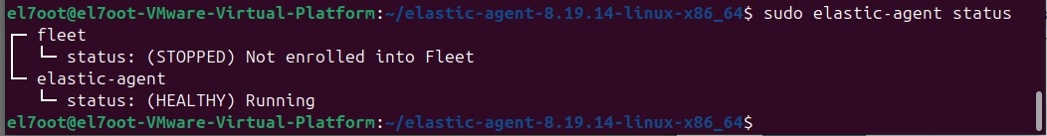
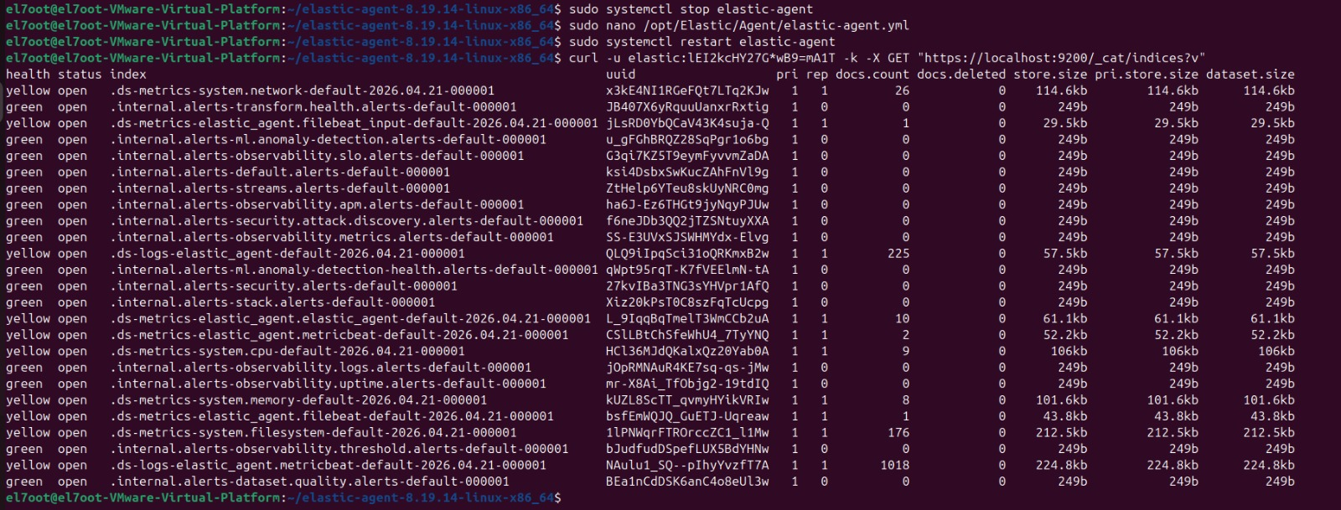
Step 3: Verification & Testing
Check that agent is running
Check that Elastic Agent can read my system log
>> curl -u elastic:lEI2kcHY27G*wB9=mA1T -k -X GET "https://localhost:9200/_cat/indices?v"

Slide 10
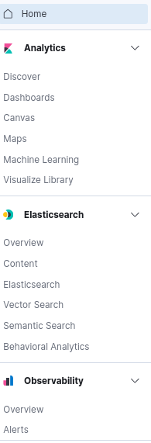
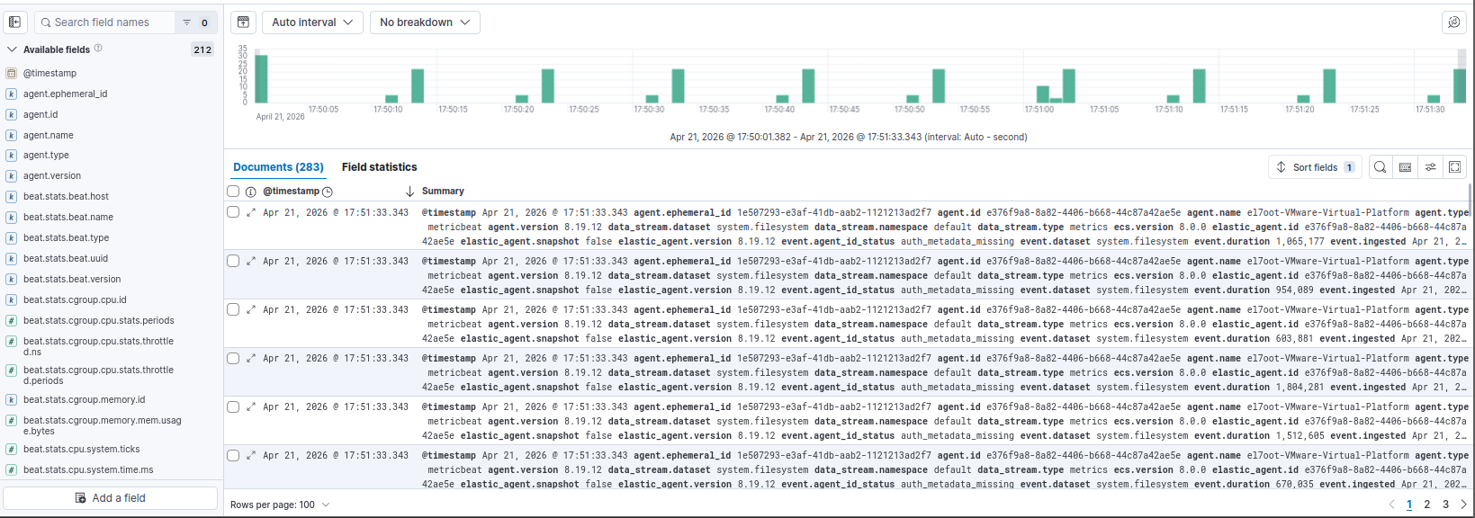
3-Dashboards & Visualization
# Discover

Slide 11
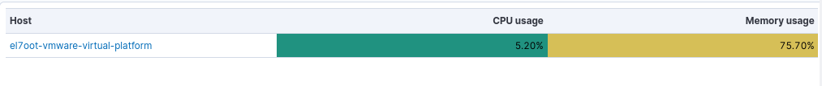
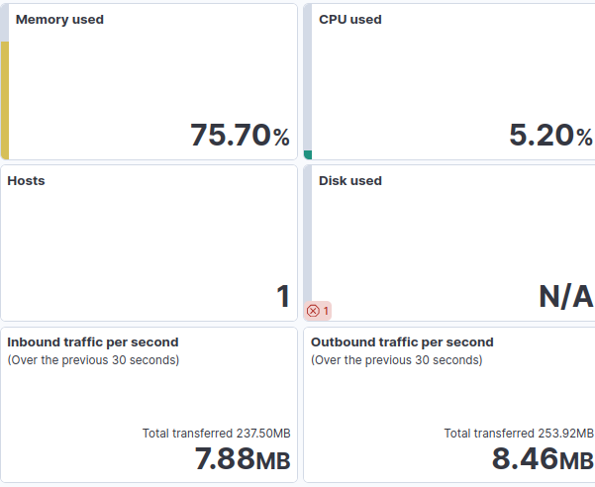
# System overview dashboard

Slide 12
Week 2
SIEM Deployment and
logs check reachability

Slide 13
Project Overview & Objectives
Goal: Build a complete SIEM environment using open-source Elastic Stack to collect, analyze, and monitor security logs.
Scope:
Central Elasticsearch + Kibana
Fleet Server to manage agents (Ubuntu server)
Windows VM (Asus)
Linux VM (kali)
Fleet Server VM (mohamed-el7oot)
KPIs:
Collect logs from all endpoints
Detect security events (e.g., process creation)
Centralized visibility in Kibana

Slide 14
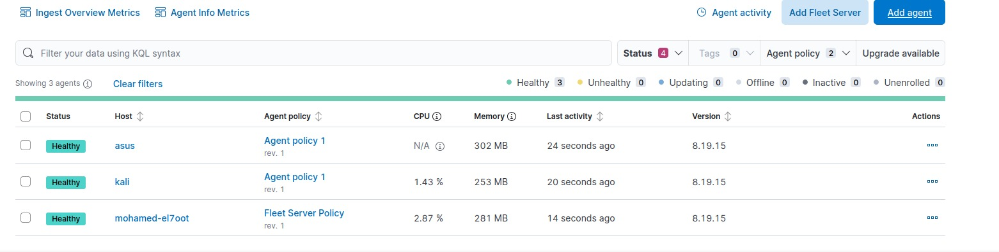
Architecture Overview
>> Devices used and their IPs
1- Elastic Stack Server 192.168.190.131
• Elasticsearch (port 9200)
• Kibana (port 5601)
•Fleet Server

Slide 15
Architecture Overview
2- Linux 192.168.190.128
attacker device used to deploy some attacks on devices
by beast using of vulnerabilities
3- Windows 192.168.190.1
Employee devices are vulnerable to attacks and need protection
NOTE :
I got IPs
• using (ip a ) on command line,
• using (ipconfig) on CMD

Slide 16
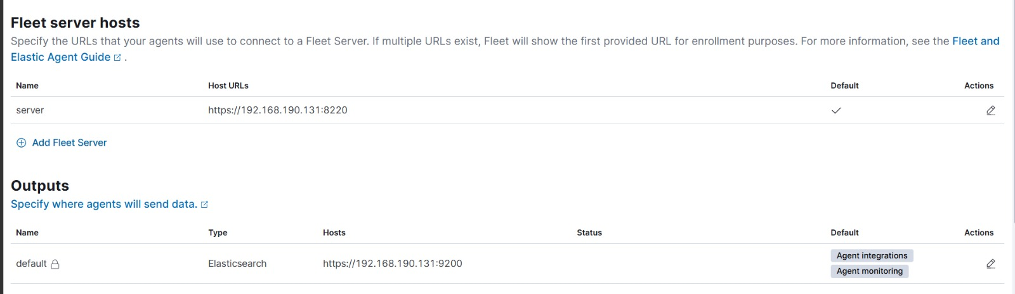
Fleet Server

Slide 17
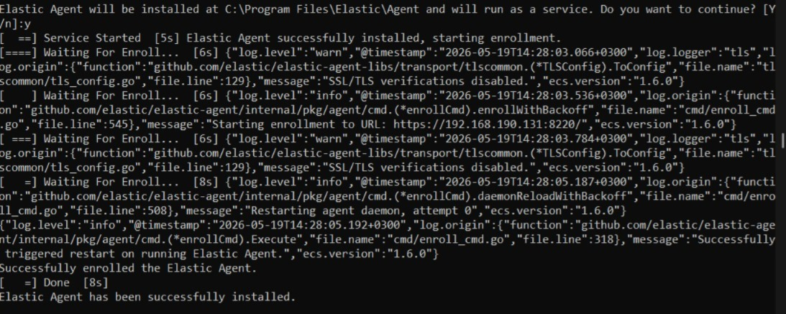
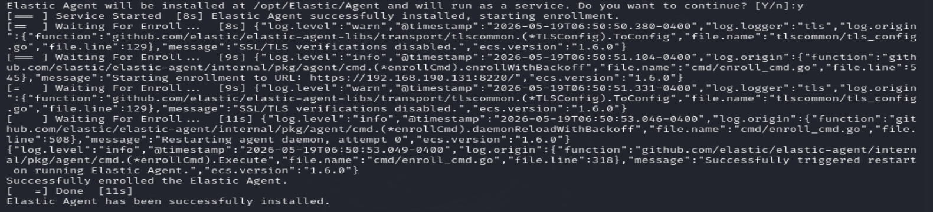
installation of Elastic Agents
> successfully installed at windows
> successfully installed at Linux

Slide 18
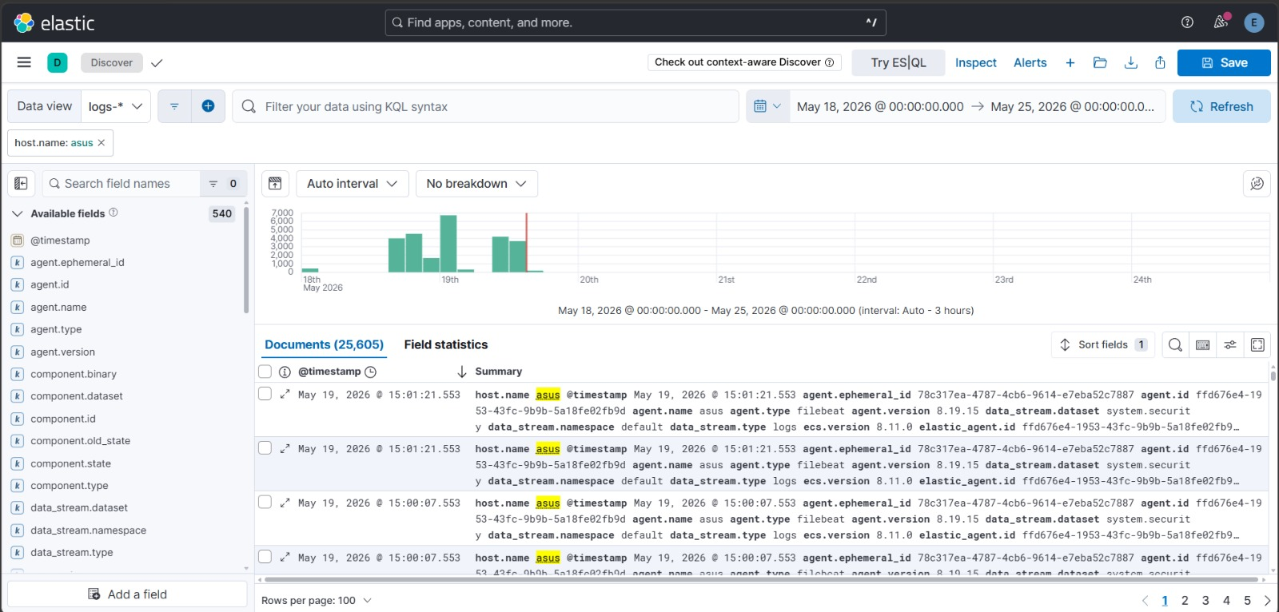
Windows Logs Analysis
All logs indexed under "logs-*" data view

Slide 19
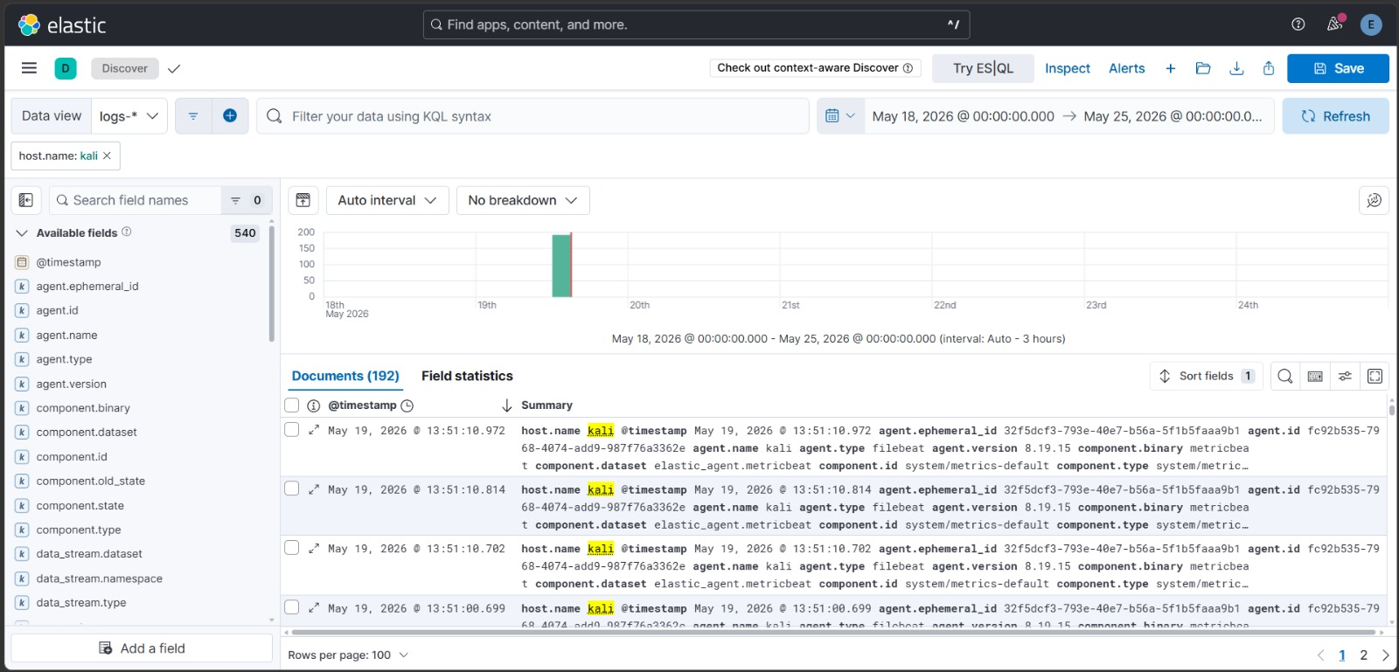
Linux Logs Analysis (kali)

Slide 20
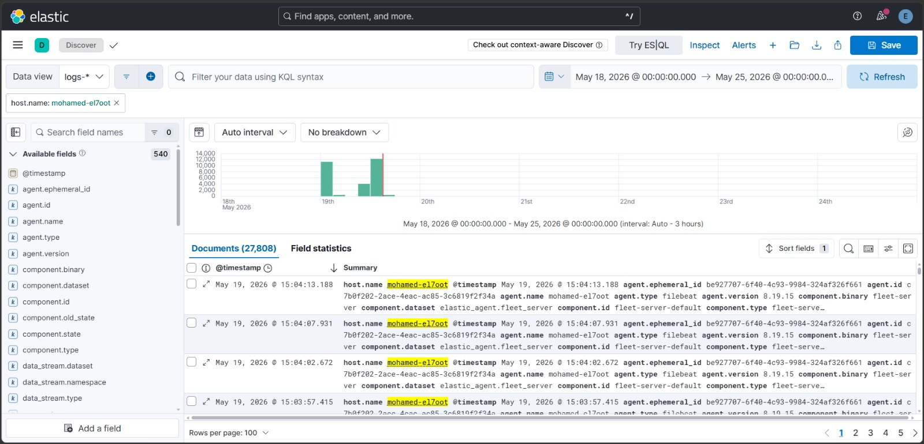
Fleet Server Internal Logs

Slide 21
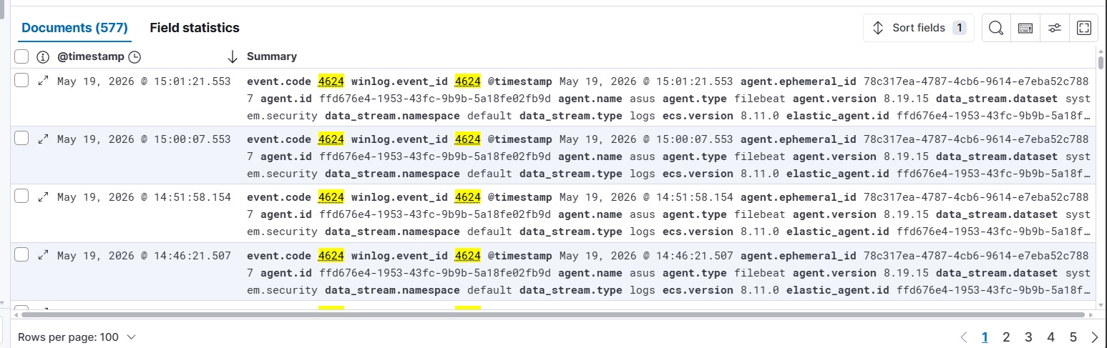
Security Event Examples
1- Event ID 4624 (Successful Logon)
, which is crucial for tracking the attacker's lateral movement or successful access. Additionally,
2-Event ID 4625 (Failed Logon) will help us detect and analyze the Brute Force attack attempts.

Slide 22
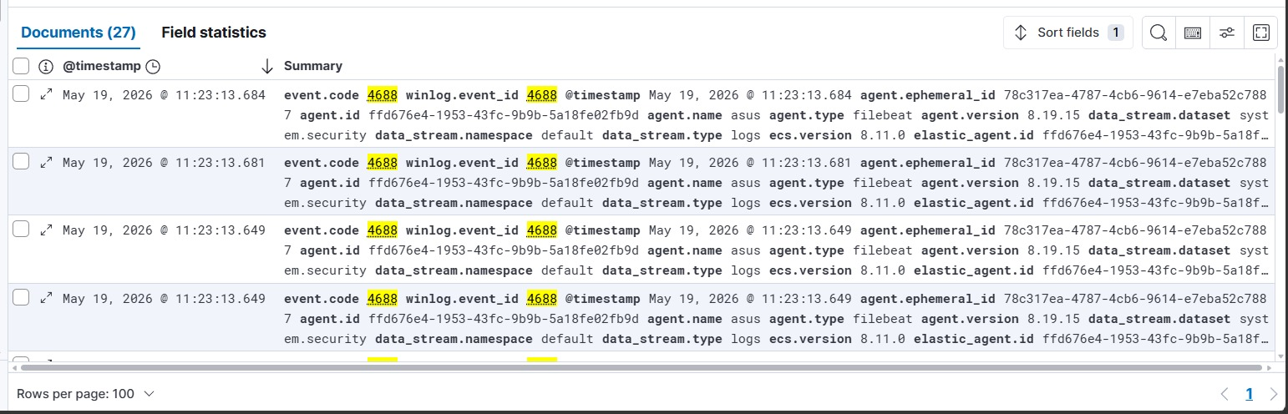
3- Event ID 4688 (Process Creation) This allows us to monitor any application launch or any command executed via CMD or PowerShell
This event ID is not enough if attacker uses Obfuscation (تشفير أو تمويه للأكواد)
so we use :
4- Event ID 4104 (Script Block Logging)
To get full visibility into PowerShell executions, which logs the actual content of the scripts and commands being executed, defeating most obfuscation techniques

Slide 23
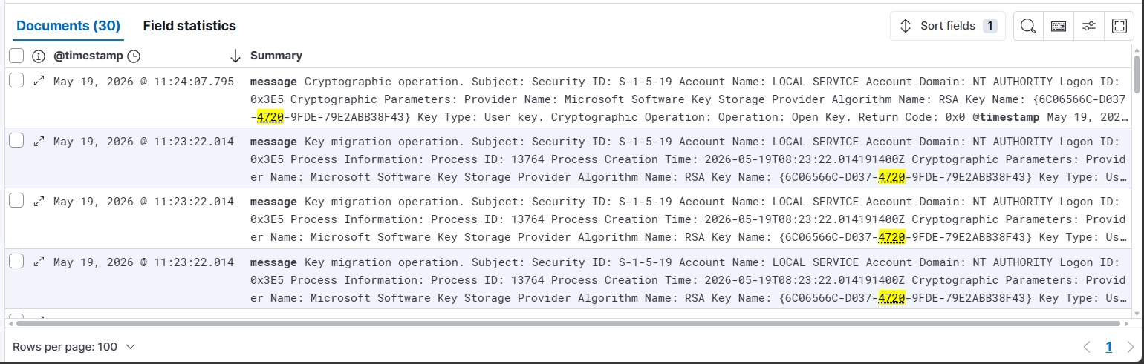
5-Event ID 4720: A user account was created
6-Event ID 4732: A member was added to a security-enabled local group (e.g., Administrators)

Slide 24
>>
Log filtering allows you to isolate specific events or analyze data within defined time periods

Slide 25
Week 3
Attack & Detection
Documentation

Slide 26
Attack & Detection Documentation
Use Case 1: Create account attack
• Tool Used: Atomic Red Team (ART)/ Command Prompt (Manual Execution)
• Target Machine (Victim): Windows 11 VM (Host Name: asus)
• MITRE ATT&CK Tactic: Persistence
• MITRE ATT&CK Technique: Create Account: Local Account (T1136.001)
• Simulation Mechanism: Self-Simulation (The host executes the technique locally to simulate a compromised scenario).
Attack Scenario Description
This test simulates a post-compromise activity where an attacker creates a new local user account on the system. This ensures the attacker maintains a "backdoor" for persistent access to the victim's environment, allowing them to log back in even if the primary vulnerability or access vector is patched.
SIEM Rule Deployment
• Rule Name: Persistence - Unauthorized Local Admin Account Created
• Severity: Medium
• Detection Logic (Event ID): 4720

Slide 27
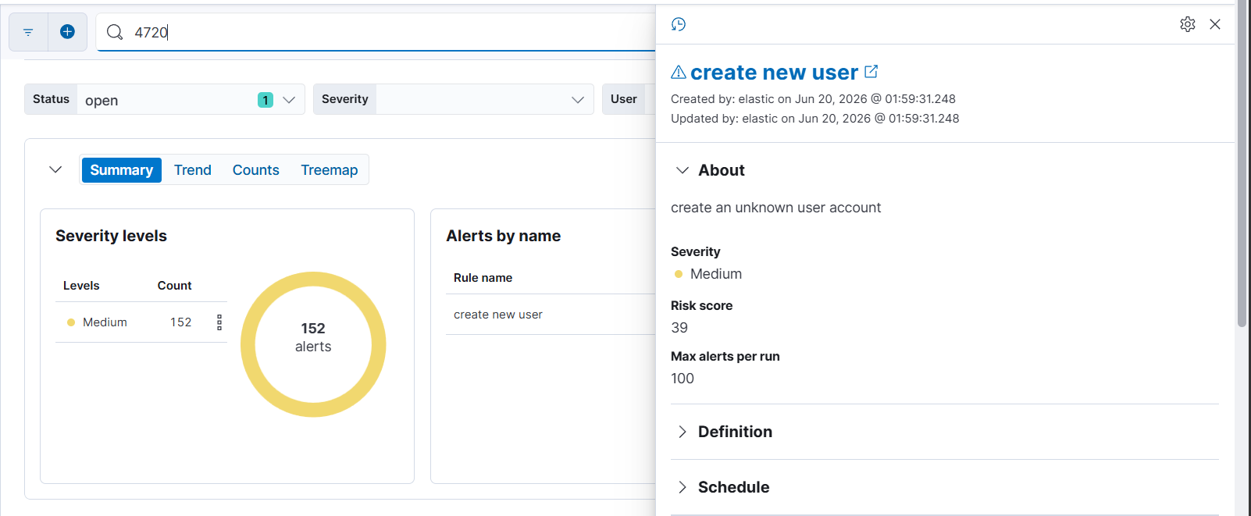
>> Create unknown user account
event_id: 4720 (إنشاء الحساب).

Slide 28

Simulate Create unknown user account using CMD
1- @ CMD write :
2- Then click Enter

Slide 29
Alert Triage:
Alert Name | Create new user
Severity | medium
Host | Asus
MITRE | T1136.001
Status | True positive
Analyst Notes | New unknown user account are created

Slide 30
Use Case 2: Privilege Escalation attack
• Tool Used: Command Prompt (Manual Execution)
• Target Machine (Victim): Windows 11 VM (Host Name: asus)
• MITRE ATT&CK Tactic: Privilege Escalation
• MITRE ATT&CK Technique: Account Manipulation (T1098)
• Simulation Mechanism: Self-Simulation (The host executes the technique locally to simulate a compromised scenario).
Attack Scenario Description
This test simulates a post-compromise activity where an attacker adds a previously created or compromised local user account to a high-privileged group, such as the local Administrators group. By doing so, the attacker successfully escalates their privileges, granting them full administrative control over the target machine to disable security controls or execute further malicious actions.
SIEM Rule Deployment
• Rule Name: Privilege Escalation - User Added to Local Administrators Group
• Severity: High
• Detection Logic (Event ID): 4732

Slide 31
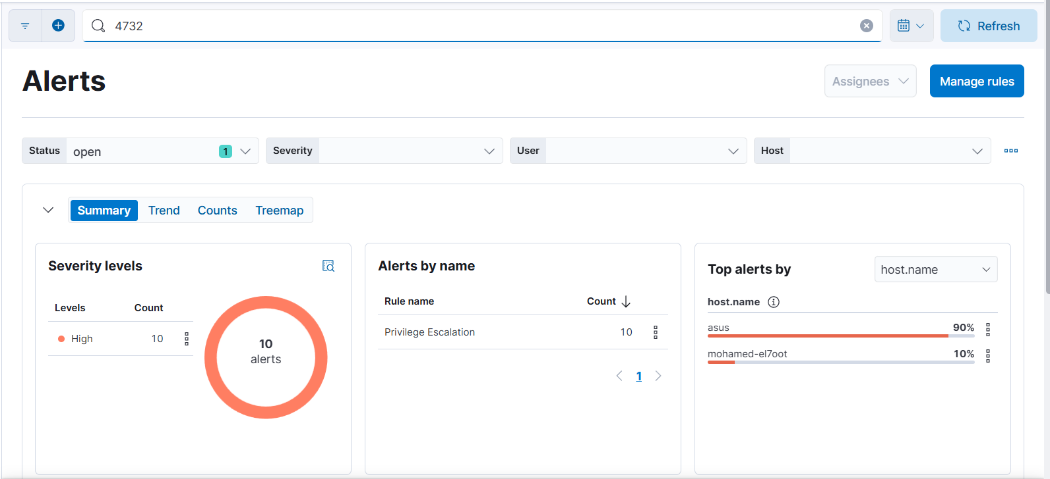
>>Privilege Escalation
event_id: 4732 (إضافته للأدمن).

Slide 32

Simulate Privilege Escalation using CMD
1- @ CMD write :
2- Then click Enter

Slide 33

Simulate attack using atomic red team
Technical Execution Steps on atomic red team
Step 1: Import the Atomic Red Team Module
Step 2: Execute the Specific Attack Test
Depend on MITRE ATT&CK ID to simulate a specific attack

Slide 34
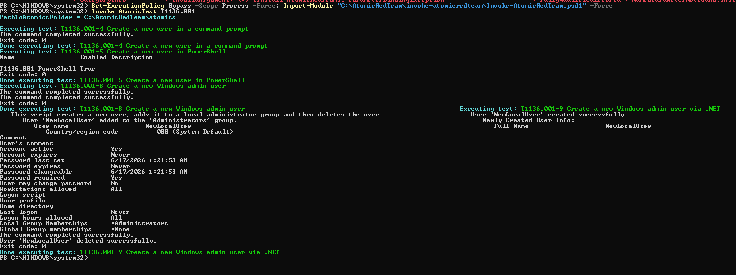
Created a new local user named NewLocalUser
Successfully added the user to the Administrators group
)Privilege Escalation(

Slide 35
Alert Triage:
Alert Name | Privilege Escalation
Severity | High
Host | Asus
MITRE | T1098
Status | True positive
Analyst Notes | Unauthorized User Added to Local Administrators Group

Slide 36
Attack & Detection Documentation
Use Case 3: Brute Force attack
• Tool Used: Atomic Red Team (ART)
• Target Machine (Victim): Windows 11 VM (Host Name: asus)
• MITRE ATT&CK Tactic: Credential Access
• MITRE ATT&CK Technique: Brute Force ) T1110(
• Simulation Mechanism: Self-Simulation (The host executes the technique locally to simulate a compromised scenario).
Attack Scenario Description
This test simulates an authentication exploitation tactic where an attacker or an automated script attempts to gain unauthorized access to a system by guessing local account passwords. By executing a rapid looping sequence of incorrect login attempts, the simulation forces the Windows subsystem to trigger defense telemetry, allowing the SOC team to detect malicious credential-hunting patterns before a successful breach occurs.
SIEM Rule Deployment
• Rule Name: Credential Access – Brute Force Detection
• Severity: Medium (Can be escalated to High if thresholds are breached within a short timeframe)
• Detection Logic (Event ID): 4625

Slide 37
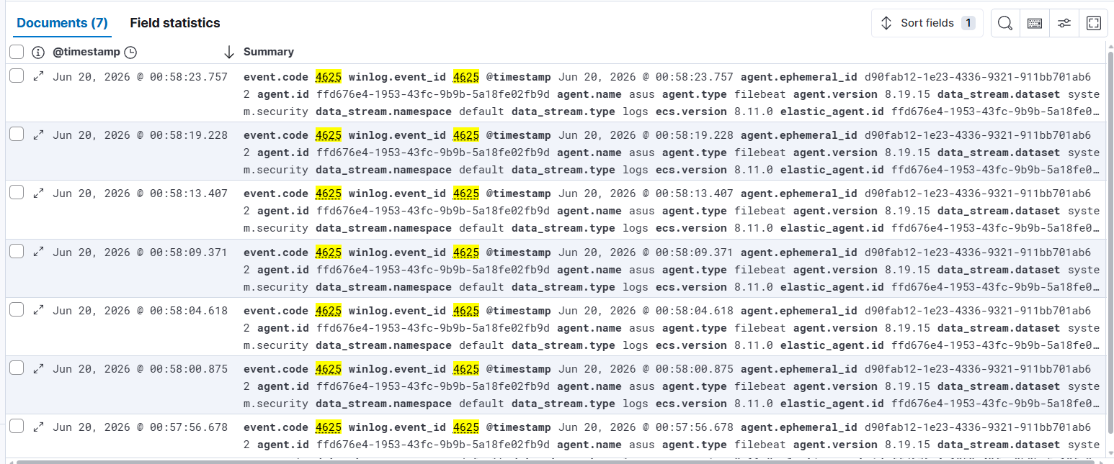
event_id: 4625 (failed login )

Slide 38
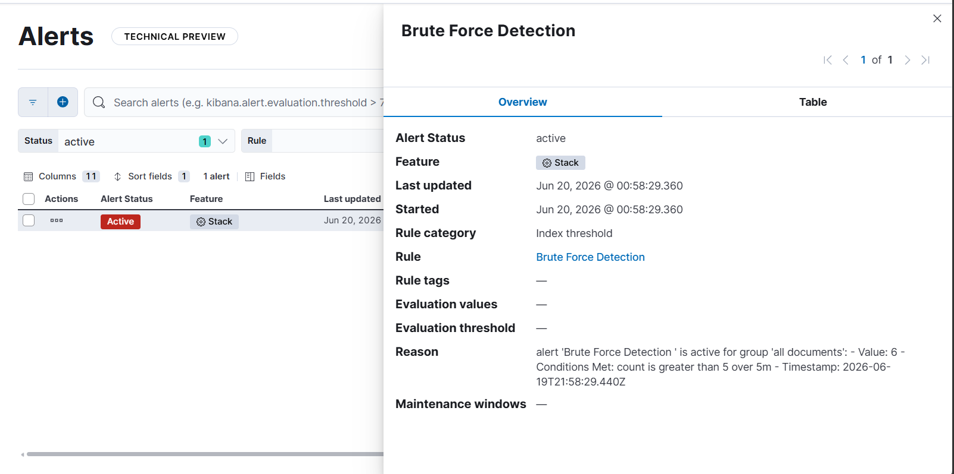
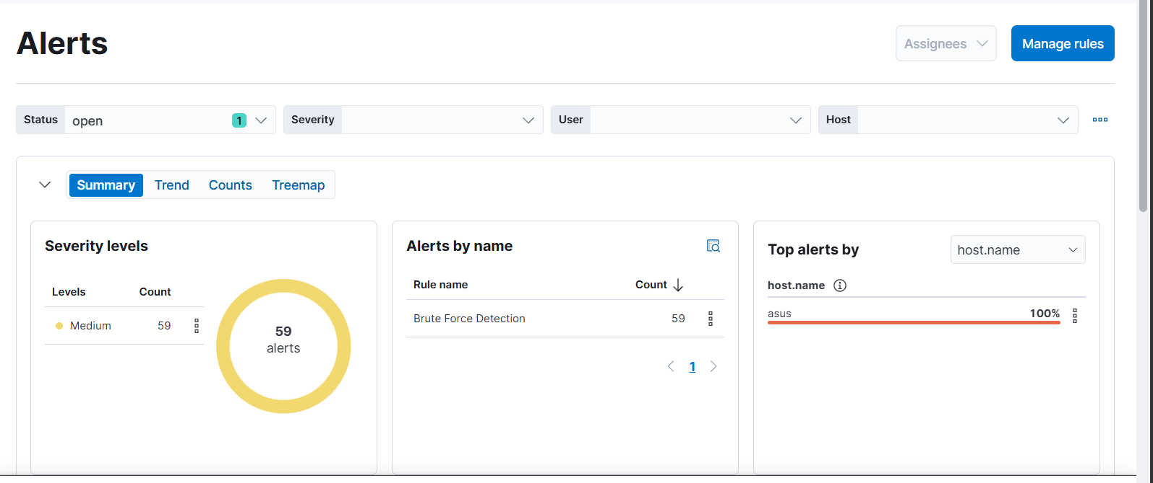

Slide 39

Simulate Brute force attack
1- @ CMD write :
2- Then click Enter
3- Then write any uncorrect password
Repeate this steps 5 times to trigger the alert

Slide 40
Alert Triage:
Alert Name | Credential Access – Brute Force Detection
Severity | Medium
Host | Asus
MITRE | T1110
Status | True Positive
Analyst Notes | Multiple failed login attempts detected

Slide 41



Indicators of Compromise (IOCs)
Use Case 1: Create account attack
•
•
Use Case 2: Privilege Escalation attack
Use Case 3: Brute Force attack
•

Slide 42
Incident Response Recommendations
Guidance notes and recommended actions to mitigate and resolve the detected attack
• Create Account
Disable suspicious account. Review local users. Audit account creation activities.
• Privilege Escalation
Remove unauthorized administrator. Review privilege assignments. Reset affected credentials.
• Brute Force
Enable account lockout policy. Change password. Enable MFA (Multi-Factor Authentication).

Slide 43
SIEM Rule Deployment & Triggering Workflow:
•
Rule Configuration: Custom detection rules are built within Kibana to continuously analyze incoming log streams from monitored endpoints.
Detection Logic: Each rule is precisely defined using KQL (Kibana Query Language) to target the specific Windows Event ID that represents a particular attack technique or suspicious activity.
Alert Triggering: When an ingested event matches the predefined Event ID and rule conditions, the SIEM automatically generates and escalates an alert to the security dashboard for analyst review.
•
•

Slide 44
Week 4
KPI Dashboard & Security Metrics

Slide 45
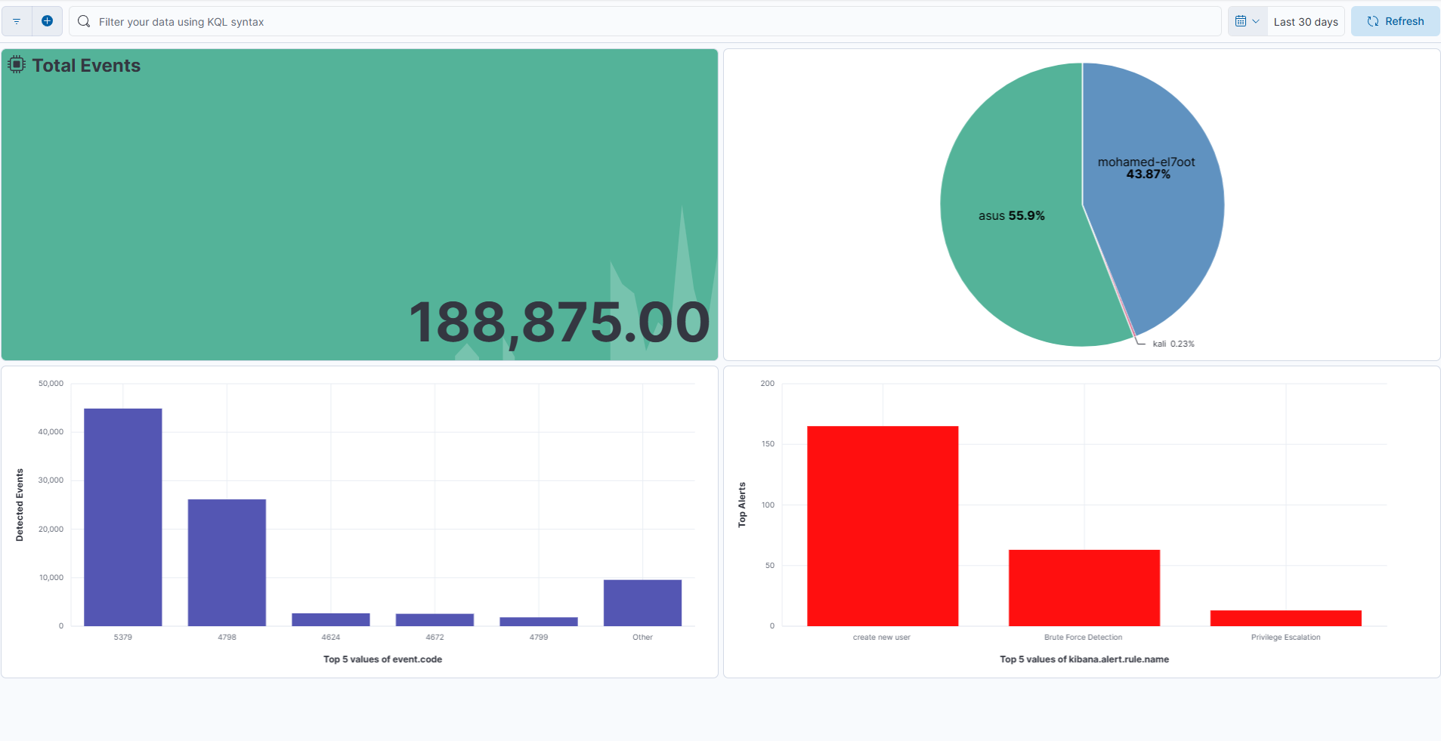
Mini SOC Security Dashboard

Slide 46

Total Events
Counts all system events

Slide 47
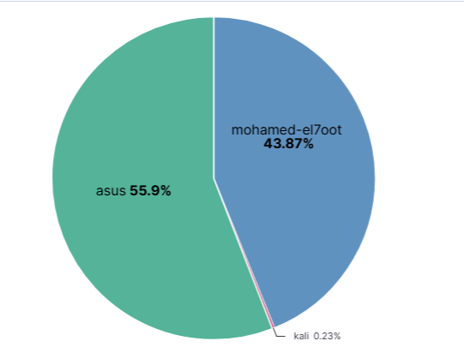
Hosts Distribution
Display system-monitored endpoints distribution

Slide 48
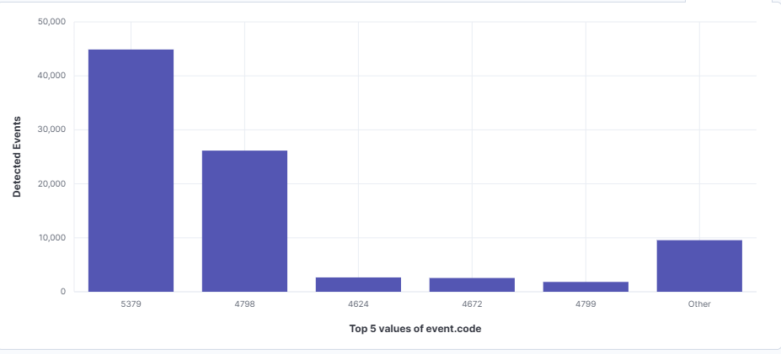
Detected Events
Display system events

Slide 49
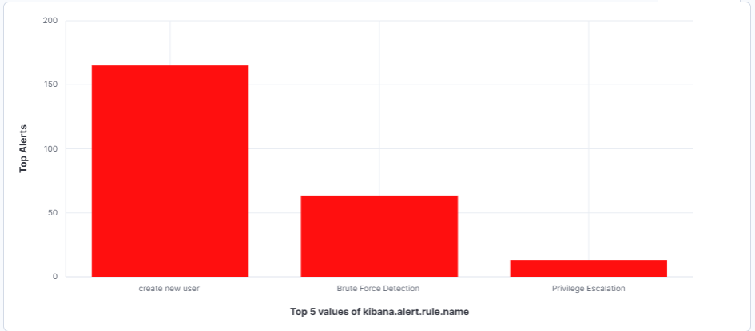
Top Alerts
Display Alerts if there is an attack

Slide 50
Perform root cause analysis for a selected incident
Root Cause Analysis
Incident
Brute Force Attack
Detection
Event ID 4625
Multiple Failed Login Attempts
Weak password policy and repeated authentication attempts allowed the attacker to perform password guessing attacks.
Root Cause
Impact
Potential unauthorized access to user accounts.
- Enable MFA.
- Implement account lockout policies.
- Use strong passwords.
- Monitor Event ID 4625.
Recommendations

Slide 51
From the Dashboards section, a new dashboard was created and customized with multiple visualizations to present security KPIs, event statistics, and monitored endpoints. The dashboard serves as a centralized monitoring interface for the SOC team, enabling analysts to quickly detect anomalies, track security incidents, analyze attack patterns, and make informed decisions during incident response activities.

Slide 52
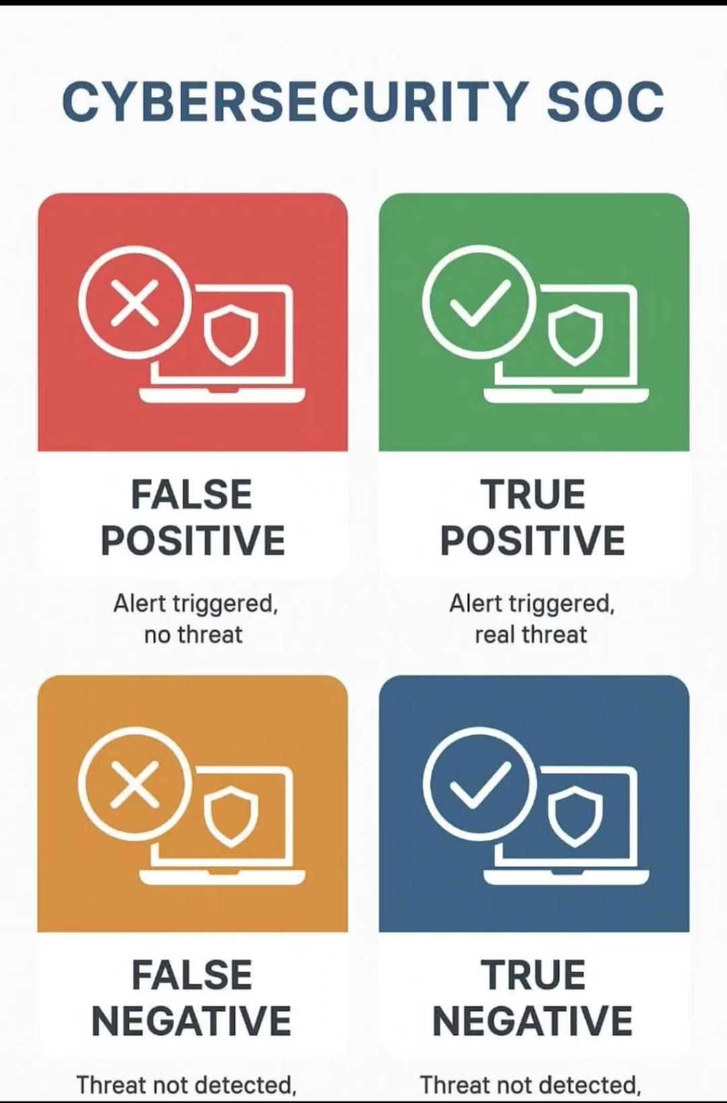
Project 1: Building and Operating a Mini Security Operations Center (SOC)
Alert triage
Threat alert
EX: False positive
No threat
There is an alert

Slide 53
Project Summary
• Successfully deployed a Mini SOC using the Elastic Stack.
• Collected and centralized logs from Windows and Linux endpoints.
• Implemented detection rules for multiple attack scenarios.
• Generated and analyzed security alerts.
• Applied MITRE ATT&CK mapping for attack classification.
• Built a KPI dashboard for security monitoring and visibility.

Slide 54
Thank you

